Slide 1

Zellige Tiles Style Infographics
Here is where this template begins

Slide 2
Zellige Tiles Infographics
01
02
03
04
Mercury
Venus
Mars
Jupiter
Mercury is the closest planet to the Sun and the smallest one
Venus has a beautiful name but is an extremely hot planet
Despite being red, Mars is actually a cold place. It’s full of iron oxide dust
Jupiter is a gas giant and the biggest planet in the entire Solar System

Slide 3
Zellige Tiles Infographics
1XXX
1XXX
2XXX
Mercury
Venus
Earth
Mercury is the smallest planet of the entire Solar System
Venus has a beautiful name but is an extremely hot planet
Earth is the third planet from the Sun and has life
Events:
Mars is cold
Venus is hot
Events:
Earth is blue
Neptune is big
Events:
Jupiter is very big
Pluto is now dwarf

Slide 4
Zellige Tiles Infographics
 | Mercury | Jupiter
Feature 01 | Mars is a cold planet | Pluto is a dwarf planet
Feature 02 | Venus is a hot planet | Earth is where we live
Feature 03 | Mercury is very small | Jupiter is a big planet
Feature 04 | Neptune is far from us | Saturn has several rings

Slide 5
Zellige Tiles Infographics
Mercury
Mercury is the smallest planet of the entire Solar System
planet Earth
Jupiter
Jupiter is the biggest planet in the entire Solar System
Earth is the third planet from the Sun and the only one that harbors life in the Solar System
Saturn
Saturn is a gas giant and has several and beautiful rings
Mars
Despite being red, Mars is actually a very cold place

Slide 6
Zellige Tiles Infographics
01
Mercury
Mercury is the smallest planet of them all
02
Saturn
Saturn was named after a Roman god and has rings
03
Jupiter
Jupiter is the biggest planet of them all

Slide 7
Zellige Tiles Infographics
Despite being red, Mars is a cold place
1XXX
Phase 01
Venus has a nice name but is hot
Jupiter is the biggest planet of them all
2XXX
Phase 02
Earth is the planet where we all live
Neptune is far away from the Sun
2XXX
Phase 03
Pluto is now considered dwarf

Slide 8
Zellige Tiles Infographics
Mars
Mars is actually a cold place
Milad un Nabi
Eid- al-Adha
Mercury is the smallest planet of the Solar System
Jupiter is the biggest planet of the entire Solar System
Venus has a beautiful name
Earth is where we all live
Pluto is now a dwarf planet
Saturn is a ringed planet

Slide 9
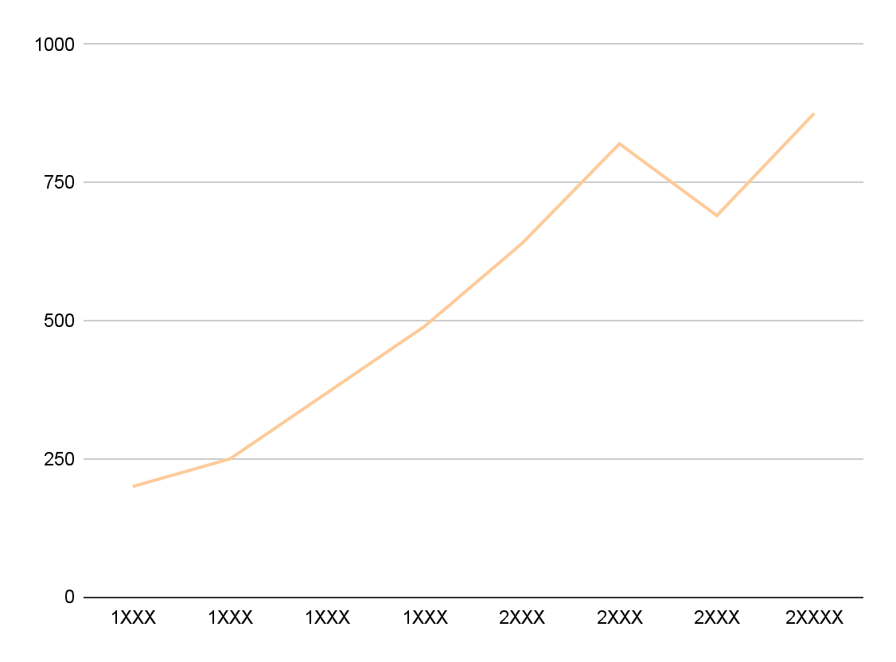
Zellige Tiles Infographics
200K
Mercury
Mercury is the closest planet to the Sun and the smallest one of them all
845K
Neptune
Neptune is the farthest planet from the Sun and is far away from us
Follow the link in the graph to modify its data and then paste the new one here. For more info, click here

Slide 10
Zellige Tiles Infographics
Planets
Mercury
Jupiter
Neptune
Saturn
Mercury is the smallest planet
Mars is actually a very cold place
Jupiter is the biggest planet
Saturn has several and beautiful rings
Neptune is far away from us
Venus has a beautiful name
Earth is where we all live
Pluto is now a dwarf planet

Slide 11
Zellige Tiles Infographics
Events calendar |  | J | F | M | A | M | J | J | A | S | O | N | D
Celebration 01 | Despite being red, Mars is a cold planet
Celebration 02 | Venus has a nice name and is hot
Celebration 03 | Earth is where we all live

Slide 12
Zellige Tiles Infographics
2,325
Mercury
Mercury is very small
Mercury is the closest planet to the Sun and the smallest of them all:
Despite being red, Mars is very cold
Venus has a beautiful name
+34%
Mars is made of basalt

Slide 13
Zellige Tiles Infographics
15%
45%
Mercury
Jupiter
Mercury is the closest planet to the Sun and is the smallest one
Jupiter is the biggest planet of the entire Solar System
30%
10%
Saturn
Neptune
Saturn has a high number of moons, like Jupiter
Neptune is the fourth-largest planet in the Solar System

Slide 14
Zellige Tiles Infographics
Egypt
Pakistan
Mercury is small
Mars is cold
Jupiter is big
Mars is red
Morocco
Turkey
Saturn has rings
Pluto is dwarf
Venus is hot
Earth is blue

Slide 15
Zellige Tiles Infographics
Mercury
Mars
Mercury is the smallest planet of the Solar System
Despite being red, Mars is actually a cold place
Earth
Saturn
Earth is the only planet known to harbor life
Saturn is composed of hydrogen and helium

Slide 16
Zellige Tiles Infographics
Mercury
Mars
Jupiter
Mercury is the smallest planet of them all
Despite being red, Mars is actually a cold place
Jupiter is the biggest planet of the Solar System
Solar System
Humility
Equality
Neptune
Earth is the only planet known to harbor life
Saturn was named after a Roman god
Neptune is the farthest planet from the Sun

Slide 17
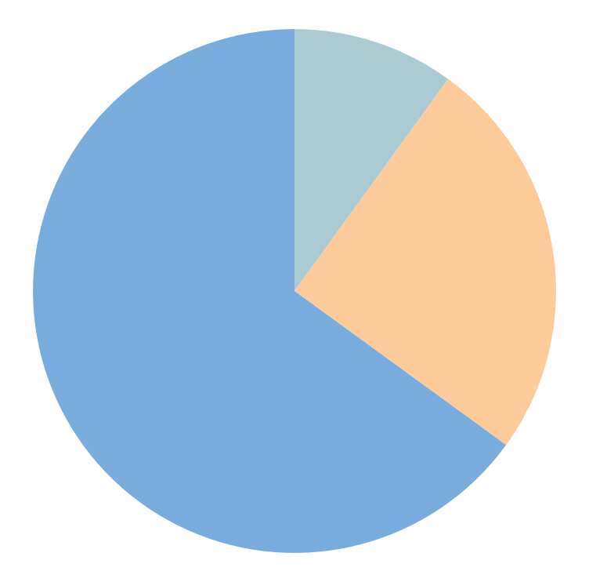
Zellige Tiles Infographics
10%
25%
Mercury
Saturn
Mercury is the smallest planet
Saturn has several and beautiful rings
65%
Earth
Earth is the planet we all live
Follow the link in the graph to modify its data and then paste the new one here. For more info, click here

Slide 18
Zellige Tiles Infographics
Mercury
Saturn is a gas giant and is composed mostly of hydrogen and helium
Mercury is the smallest planet of them all
Solar System
Jupiter
Neptune is the farthest planet from the Sun. It’s also the fourth-largest
Jupiter is the biggest planet of the Solar System

Slide 19
Zellige Tiles Infographics
 | Solar System
Mercury | Feature 01 | Feature 02 | Feature 03
Earth | Feature 01 | Feature 02 | Feature 03
Venus | Feature 01 | Feature 02 | Feature 03

Slide 20
Zellige Tiles Infographics
Book 01
Book 02
“Mercury is the closest planet to the Sun”
“Despite being red, Mars is a cold place”
“Earth is the third planet from the Sun”
“Moon is Earth’s natural satellite”
1/5
2/5
Book 03
Book 04
“Ceres is located in the main asteroid belt”
“Saturn is a gas giant and has several rings”
“Neptune is the farthest planet of them all”
“Sun is the center of the Solar System”
4/5
5/5

Slide 21
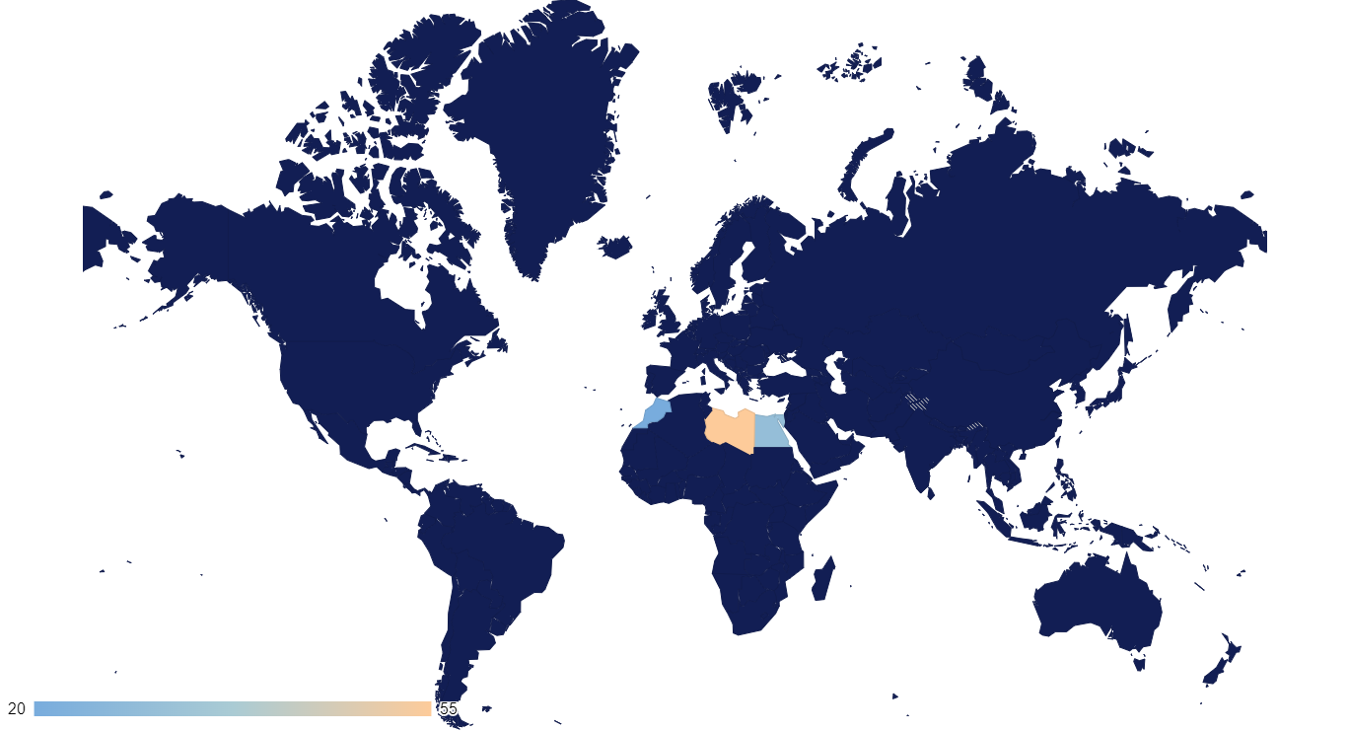
Zellige Tiles Infographics
Mercury
Mars
Jupiter
Earth
Mars
Earth
Neptune
40%
25%
55%
30%
Mercury
Venus
Saturn
Pluto
60%
Follow the link in the graph to modify its data and then paste the new one here. For more info, click here

Slide 22
Zellige Tiles Infographics
1XXX
20%
Mercury
2XXX
80%
Mercury
1XXX
60%
65%
35%
Saturn
Mercury
Saturn
2XXX
40%
Mercury is the smallest planet
Saturn was named after a god
Saturn

Slide 23
Zellige Tiles Infographics
5%
15%
30%
50%
Mercury
Saturn
Neptune
Earth
Mercury is the closest planet to the Sun and the smallest one
Saturn has a high number of moons, like Jupiter
Neptune is the farthest planet from the Sun
Earth is the only planet known to harbor life

Slide 24
Zellige Tiles Infographics
Mercury
Mars
01
Mercury is the smallest planet
Mars is made of basalt and is cold
04
02
03
Saturn
Earth
Saturn is a planet with rings
Earth is where we all live

Slide 25
Zellige Tiles Infographics
Mercury
01
Mercury is the closest planet to the Sun
Neptune
02
Neptune is the farthest planet from the Sun
Saturn
03
Saturn is one of the gas giants with rings
Earth
04
Earth is the only planet known to harbor life

Slide 26
Zellige Tiles Infographics
Feature | Origin | Name | Description
Feature 01 Mars is actually a cold place | 1XXX | Mars | Mercury is small
Feature 02 Venus is a hot place | 1XXX | Venus | We all live on the Earth
Feature 03 Earth is the Blue Planet | 2XXX | Earth | Jupiter is a big planet

Slide 27
Zellige Tiles Infographics
Mercury
Jupiter
Solar System
Mercury is the closest planet to the Sun and the smallest one
Jupiter is a gas giant and the biggest planet in the entire Solar System

Slide 28
Zellige Tiles Infographics
Mercury
The Moon
Mercury is a small planet
Moon is Earth’s satellite
Earth
Saturn has a high number of moons
Mars is made of basalt and is actually cold
Neptune is the farthest planet from the Sun
Pluto is now considered a dwarf planet
Earth is the third planet from the Sun
Jupiter
Jupiter is the biggest planet of them all

Slide 29
Zellige Tiles Infographics
Mercury
01
Mars
02
Mercury is the closest planet to the Sun
Mars is made of basalt and is actually very cold
Saturn
03
Earth
04
Saturn has a beautiful and several rings
Earth is the only planet known to harbor life
Neptune
05
Jupiter
06
Neptune is the farthest planet from the Sun
Jupiter is a gas giant and the biggest planet

Slide 30
Zellige Tiles Infographics
Month, 12
Month 2XXX
Sun | Mon | Tue | Wed | Thu | Fri | Sat
 |  |  |  |  | 1 | 2
3 | 4 | 5 | 6 | 7 | 8 | 9
10 | 11 | 12 | 13 | 14 | 15 | 16
17 | 18 | 19 | 20 | 21 | 22 | 23
24 | 25 | 26 | 27 | 28 | 29 | 30
Mercury
Mercury is the closest planet to the Sun
Month, 13 to 20
Jupiter
Jupiter is the biggest planet of them all

Slide 31
Zellige Tiles Infographics
Time | Sun | Mon | Tue | Wed | Thu | Fri | Sat
9:00h
10:00h
11:00h
12:00h
13:00h
Mercury
Mars
Venus

Slide 32
Instructions for use
If you have a free account, in order to use this template, you must credit Slidesgo in your final presentation. Please refer to the next slide to read the instructions for premium users.
As a Free user, you are allowed to:
- Modify this template.
- Use it for both personal and commercial projects.
You are not allowed to:
- Sublicense, sell or rent any of Slidesgo Content (or a modified version of Slidesgo Content).
- Distribute Slidesgo Content unless it has been expressly authorized by Slidesgo.
- Include Slidesgo Content in an online or offline database or file.
- Offer Slidesgo templates (or modified versions of Slidesgo templates) for download.
- Acquire the copyright of Slidesgo Content.
For more information about editing slides, please read our FAQs or visit our blog:
https://slidesgo.com/faqs and https://slidesgo.com/slidesgo-school

Slide 33
Instructions for use (premium users)
As a Premium user, you can use this template without attributing Slidesgo.
You are allowed to:
Modify this template.
Use it for both personal and commercial purposes.
Share this template in an editable format with people who are not part of your team.
You are not allowed to:
Sublicense, sell or rent this Slidesgo Template (or a modified version of this Slidesgo Template).
Distribute this Slidesgo Template (or a modified version of this Slidesgo Template) or include it in a database or in any other product or service that offers downloadable images, icons or presentations that may be subject to distribution or resale.
Use any of the elements that are part of this Slidesgo Template in an isolated and separated way from this Template.
Register any of the elements that are part of this template as a trademark or logo, or register it as a work in an intellectual property registry or similar.
For more information about editing slides, please read our FAQs or visit our blog:
https://slidesgo.com/faqs and https://slidesgo.com/slidesgo-school

Slide 34
Infographics
You can add and edit some infographics to your presentation to present your data in a visual way.
Choose your favourite infographic and insert it in your presentation using Ctrl C + Ctrl V or Cmd C + Cmd V in Mac.
Select one of the parts and ungroup it by right-clicking and choosing “Ungroup”.
Change the color by clicking on the paint bucket.
Then resize the element by clicking and dragging one of the square-shaped points of its bounding box (the cursor should look like a double-headed arrow). Remember to hold Shift while dragging to keep the proportions.
Group the elements again by selecting them, right-clicking and choosing “Group”.
Repeat the steps above with the other parts and when you’re done editing, copy the end result and paste it into your presentation.
Remember to choose the “Keep source formatting” option so that it keeps the design. For more info, please visit our blog.

